Slide 1
Types of Business Intelligence Tools and Applications
Ad hoc analysis
Online Analytical processing
Mobile BI
Real time BI
Operation Intelligence
Open-Source BI
Embedded BI
Collaborative BI
Location Intelligence
Business intelligence vendors and market
Sehrish Aqeel
www.aisciences.io

Slide 2
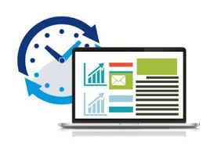
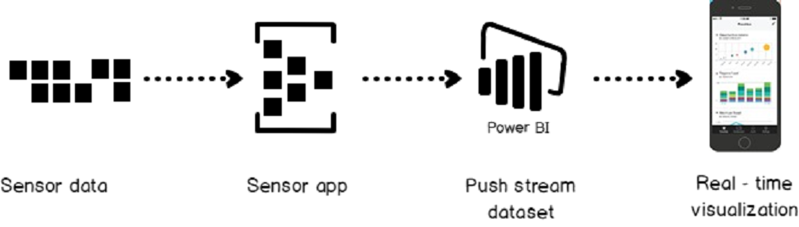
Real time Business Intelligence
Real-time business intelligence is an approach to data analytics that enables business users to get up-to-the-minute data by directly accessing operational systems or feeding business transactions into a real-time data warehouse and business intelligence (BI) system.

Slide 3

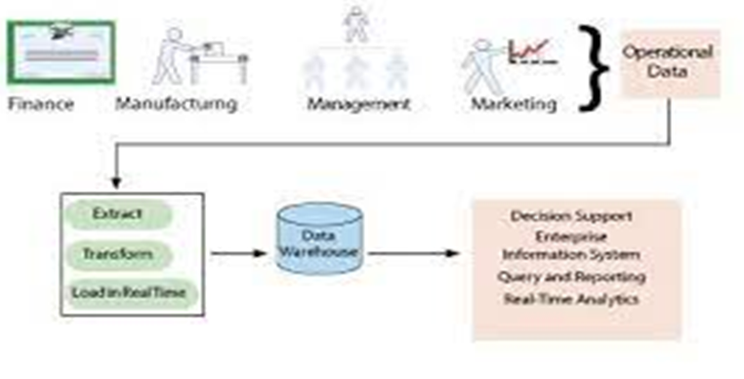
Real time Business Intelligence

Slide 4
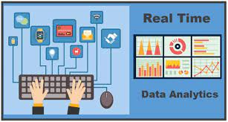
Real time Business Intelligence
The technologies that can be used to enable real-time BI include:
data virtualization
data federation
enterprise information integration (EII)
enterprise application integration (EAI)
service-oriented architectures (SOA)
Complex event processing tools can be used to analyze data streams in real time and either trigger automated actions or alert workers to patterns and trends.

Slide 5
